Slide 1
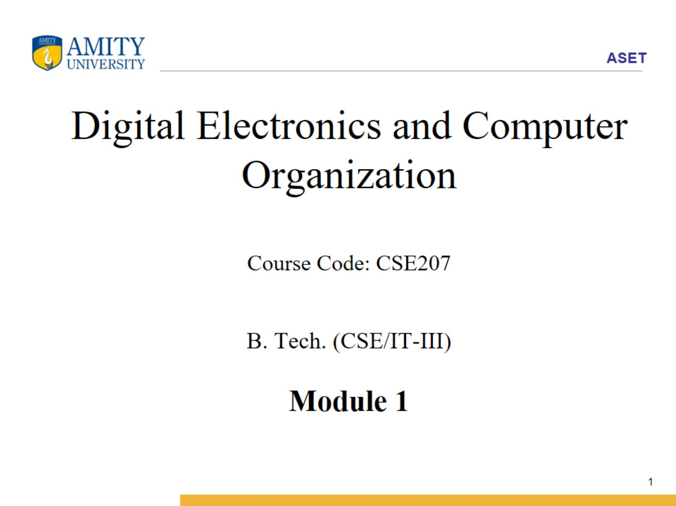
Digital Electronics and Computer Organization Course Code: CSE207 B. Tech. (CSE/IT-III) Module 1

Slide 2
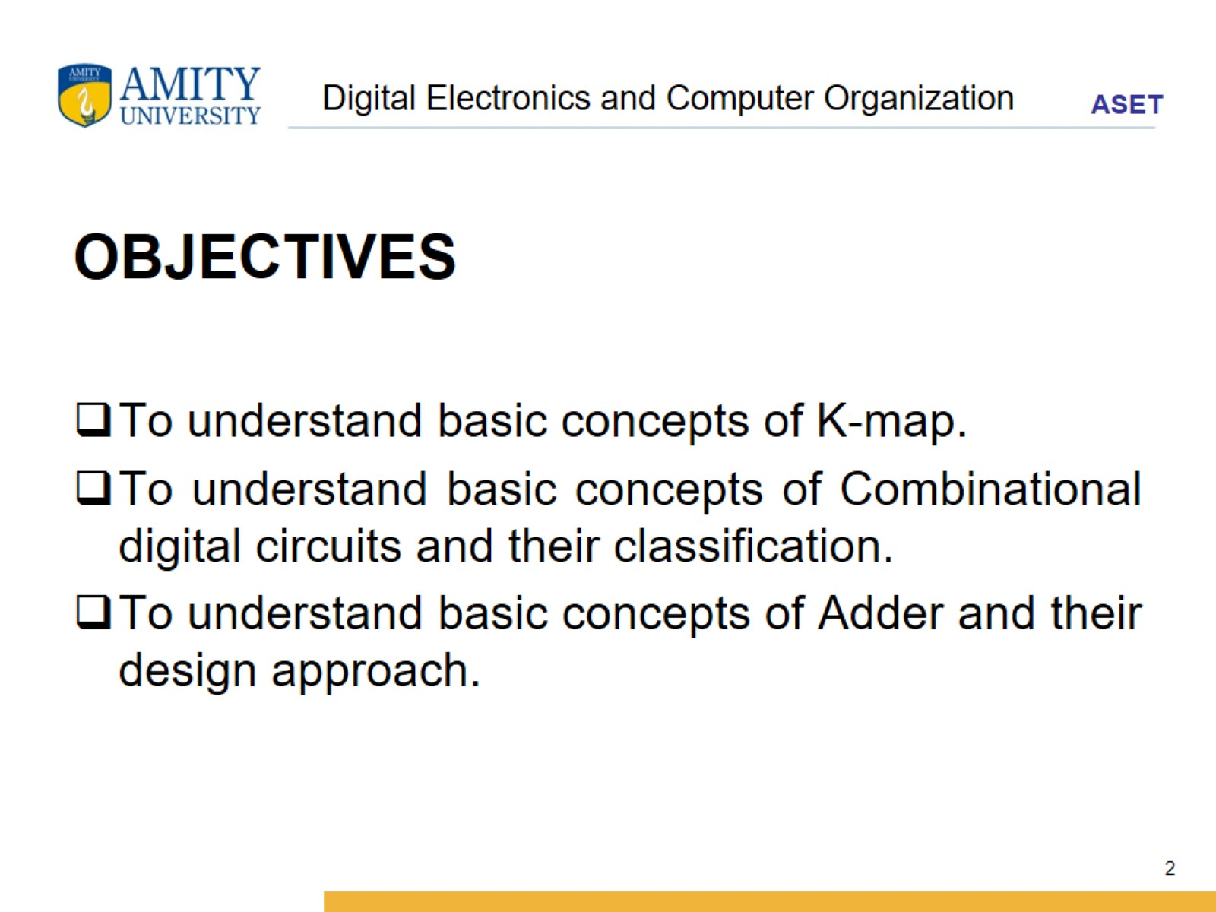
Digital Electronics and Computer Organization

Slide 3
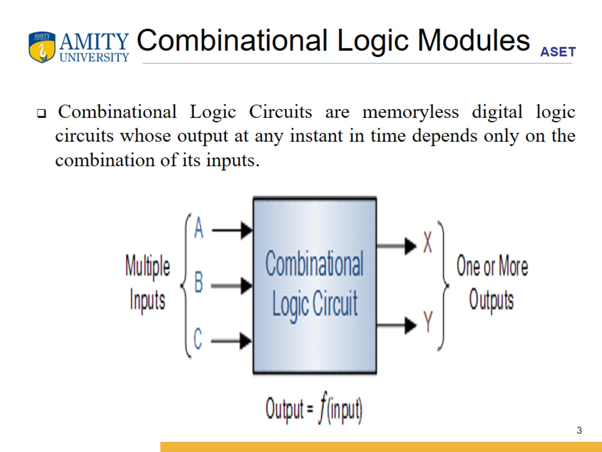
Combinational Logic Modules

Slide 4
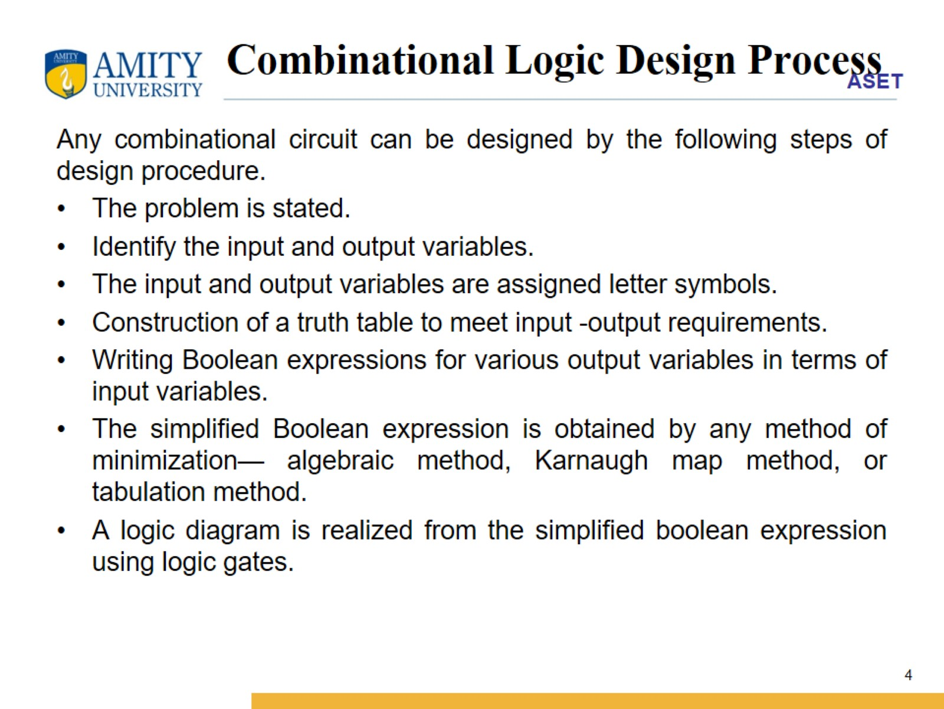
Combinational Logic Design Process

Slide 5
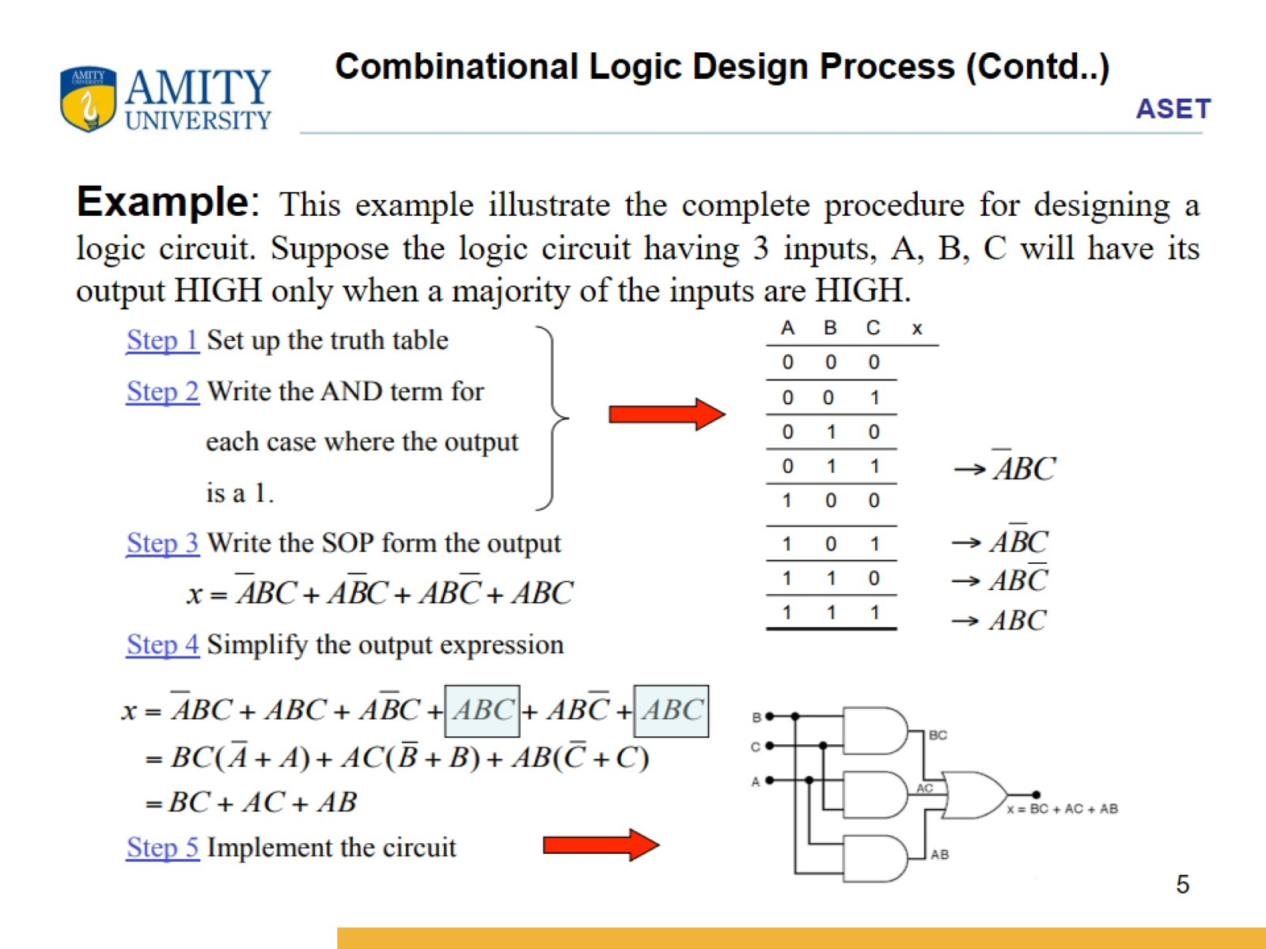
Combinational Logic Design Process (Contd..)

Slide 6
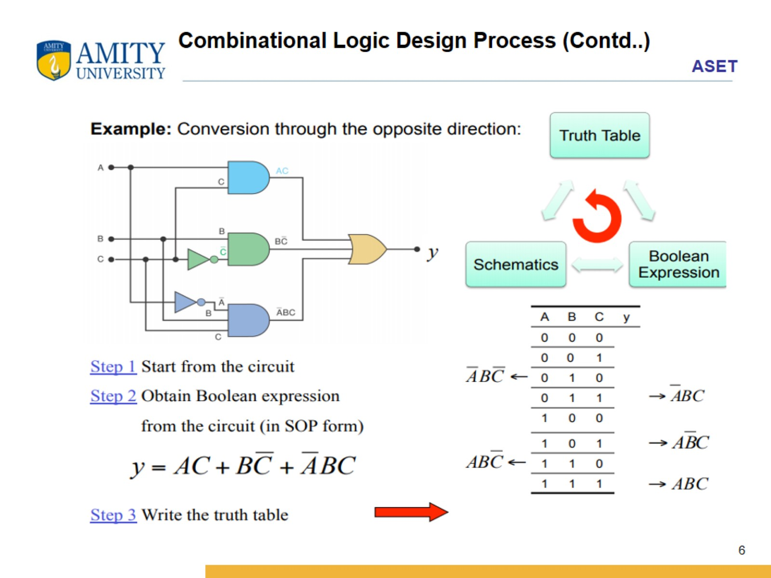
Combinational Logic Design Process (Contd..)

Slide 7
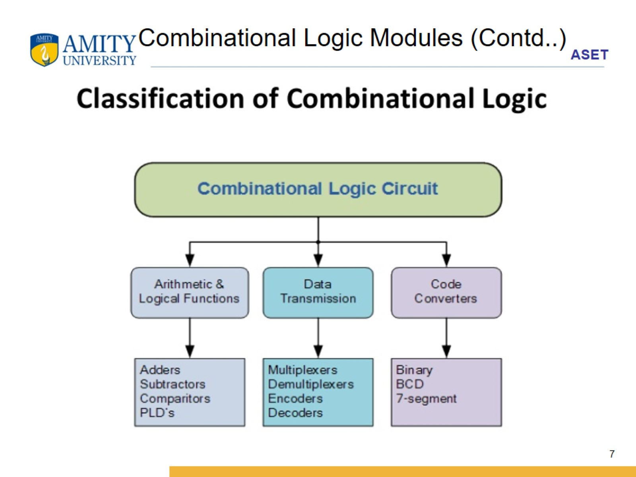
Combinational Logic Modules (Contd..)

Slide 8
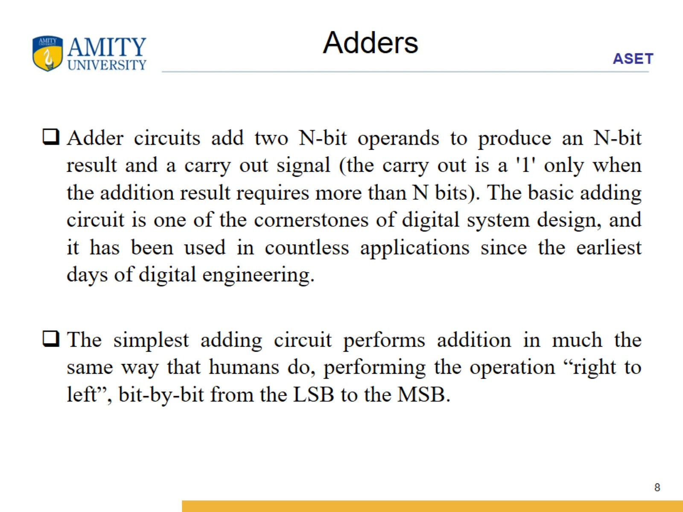
Adders

Slide 9
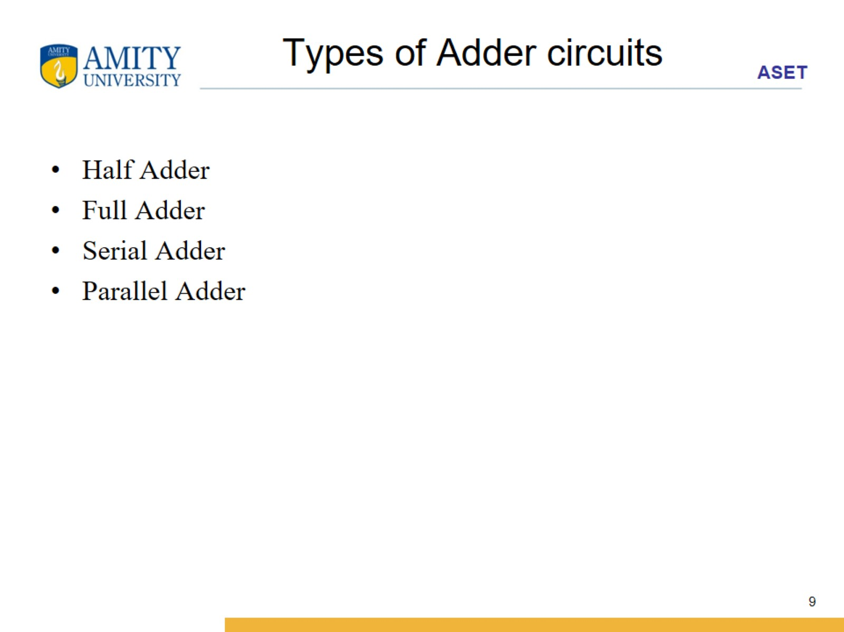
Types of Adder circuits

Slide 10
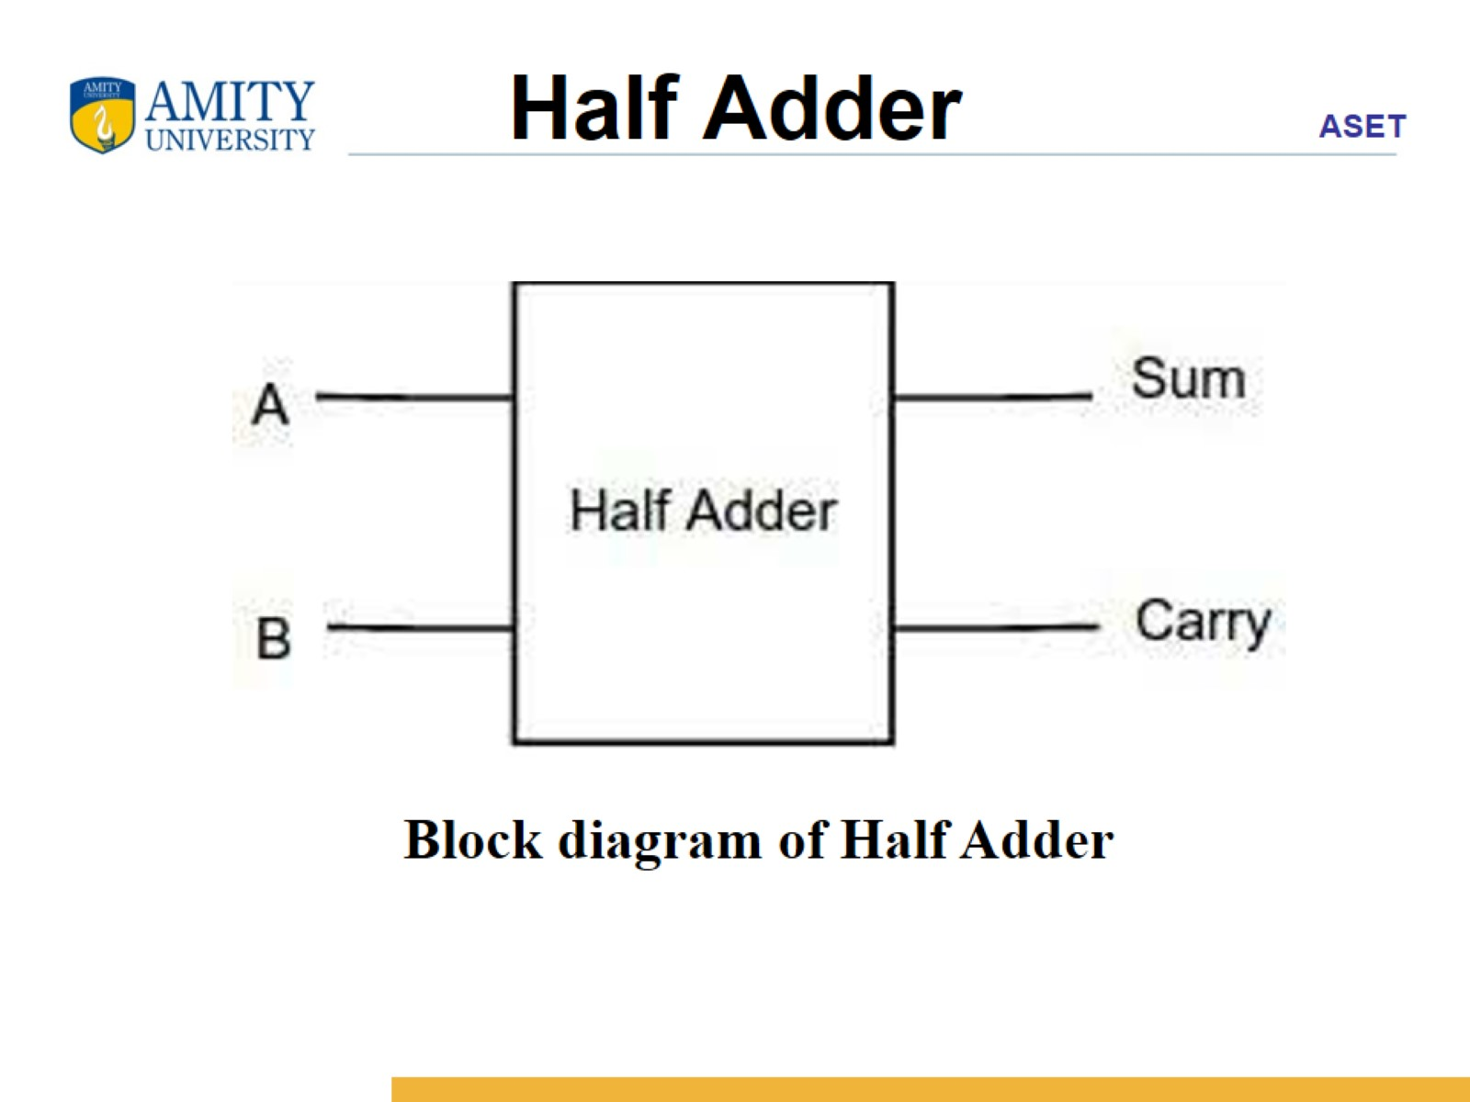
Half Adder

Slide 11
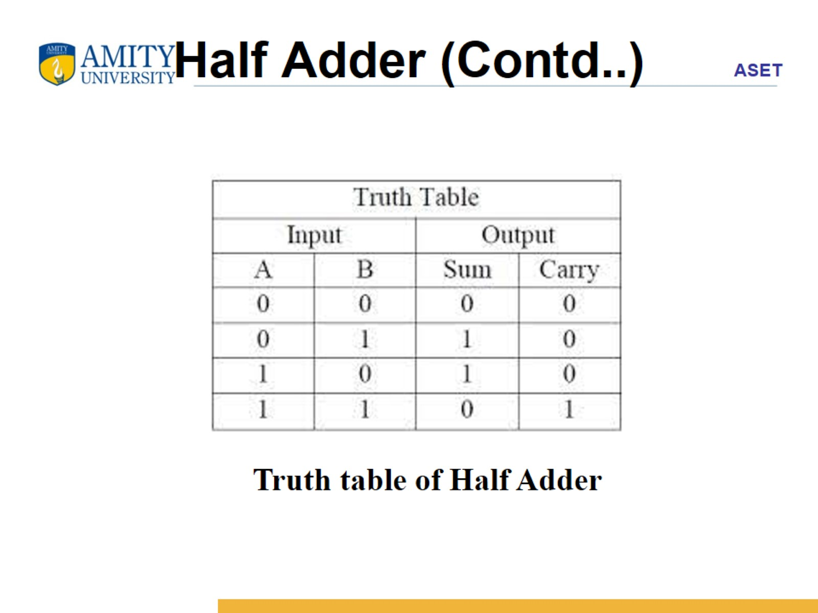
Half Adder (Contd..)

Slide 12
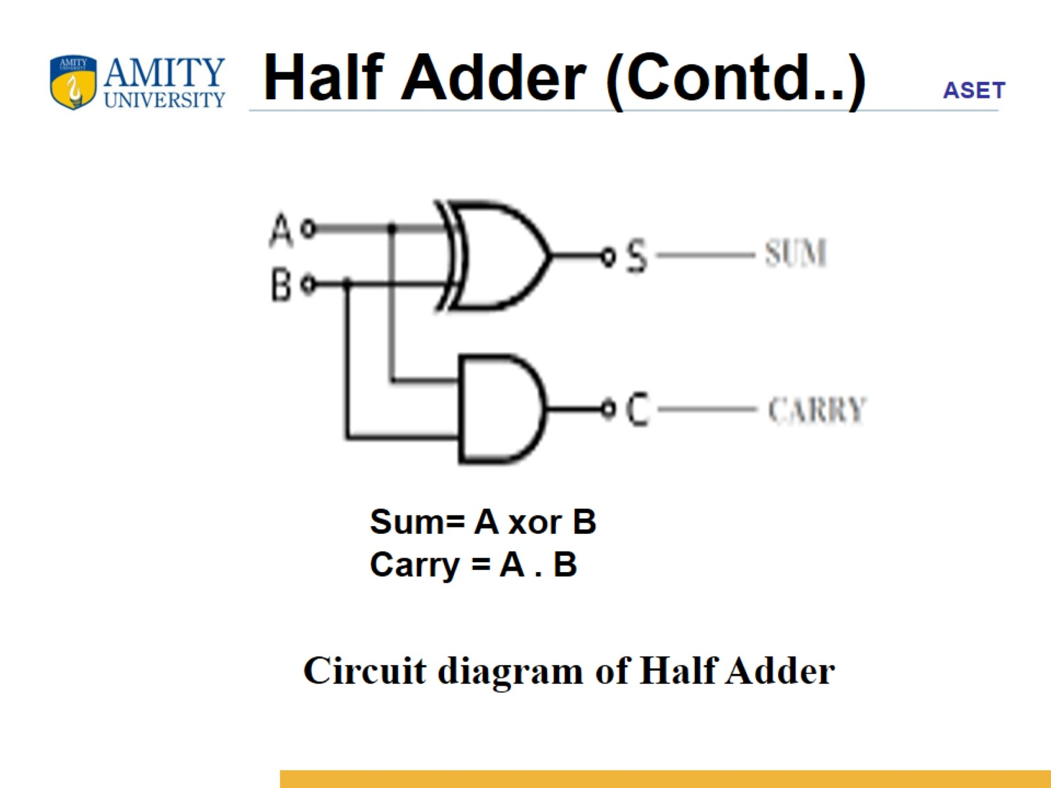
Half Adder (Contd..)

